Slide 1


Sleeman
Data Analyst Agent
Dec 2

Slide 2


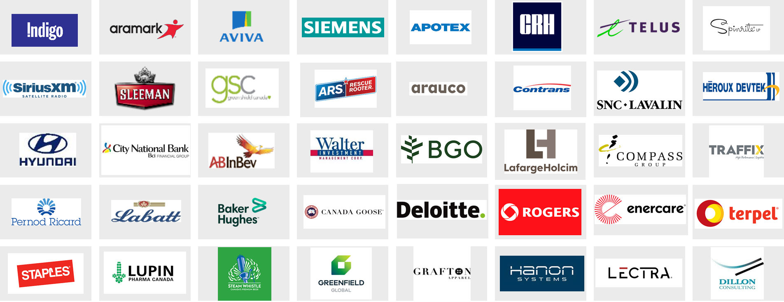












Our mission is to provide the best advice, products and services to enable our customers turn data into information, enhance it with AI and make great decisions.
Canada
Headquarters: Toronto
United States
Headquarters: Miami
South America
Headquarters: Colombia
10 Years in Operation
150+ Clients Served
400+ BI Projects
9 Products in the Microsoft Marketplace
10+ Technology Partnerships
10 Years with Longest Customer
Infrastructure Design & Technology Selection
Industry Leading Partnerships

Slide 3



Data Engineering & Modernization
Advanced Analytics & BI
AI Strategy & Implementation

Slide 4

AI In Brewing
Why leading brewers are adopting AI now
AI Unlocks Advantage
First-Mover Opportunity
•Real-time operational intelligence across facilities
•Predictive insights replacing reactive decision-making
•Proprietary data assets creating competitive moats
The Canadian brewing market is ripe for disruption. Early adopters will establish sustainable operational advantages that competitors cannot easily replicate.

Slide 5


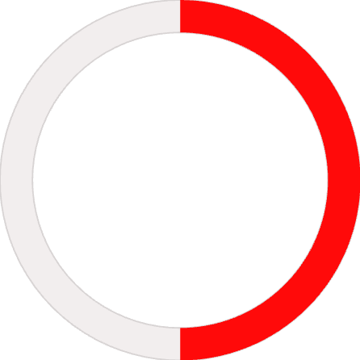
Value Case
Quantified Time and Cost Impact
Annual Cost Savings (Steady State)
$500K
$225K
$300K
$160K
Fermentation Optimization
Quality Defects
Waste Reduction
Energy Optimization
Capacity gains and consistency improvements
Early detection and prevention
Forecast-driven inventory and production planning
Smart scheduling and resource allocation
Time Savings
80%
75%
50%
Data Analysis
Forecasting Cycles
Quality Inspection
7+ hours per analyst weekly reclaimed from manual reporting
8 days reduced to 1 day for demand planning
Manual QA time cut in half through automation
Total Annual Benefit: $1.8M - $3.2M | Payback Period: 12-18 months

Slide 6
Data Analyst Agent Deep Dive
Your Intelligent Operations Assistant
What It Does
Translates a natural language request into a SQL query and retrieves the data in real time.
Answer questions in natural language: "What was our fill rate for Sleeman Original last month?"
Key Capabilities
RAG-powered knowledge base with recipes, SOPs, and historical data
Multi-agent orchestration connecting fermentation, quality, and supply chain insights
Bilingual support (English/French) for Chambly operations
Executive reporting automation with one-click generation
____________________________________________________
____________________________________________________
Ask in Plain Language
Get Instant Answer
No SQL or technical skills required
Seconds, not hours, with source citations

Slide 7
How Implementation Works
Phase 1: Foundation
Phase 2: Expansion
Phase 3: Optimization
Months 1-4
Months 5-8
Months 9-12
Infrastructure setup and data integration
Guelph facility pilot launch
Data Analytics Agent deployment
Training for 20 pilot users
Advanced analytics and natural language interface
Full platform integration
200+ active users organization-wide
Rollout to all 4 facilities
Enhanced supply chain and compliance features
Scale to 100+ users

Slide 8
Cost
Estimated Budget
DEPARTEMENT | HOURLY RATE | HOUR | TOTAL
Design | $60 | 240 | $14.400
Marketing | $60 | 160 | $9.600
Strategy | $100 | 124 | $12.400
Project Management | $85 | 160 | $13.600
Total Estimated |  |  | $50.000
Strategic budget allocation involves analyzing and prioritizing development, marketing, and ongoing improvements to maximize impact. The focus is on efficiency and effectiveness, with a calculated investment in areas that contribute to project success and growth.

Slide 9
Next Steps
Technical Discovery
Business Case Refinement
Pilot Proposal
Weeks 1-2
Weeks 3-4
Week 5
Site visit to Guelph facility
Rockwell PlantPAx integration assessment
Data readiness evaluation
Baseline metric collection
ROI model customatization to Sleeman specifics
Stakeholder interviews
Detailes statement of work
Fixed-price pilot engagement
Success criteria definition

Slide 10
Available dates
February | March | April | May
www.reallygreatsite.com

